Slide 1
Firebase 在移动端的应用
张海龙（Jason）

Slide 2
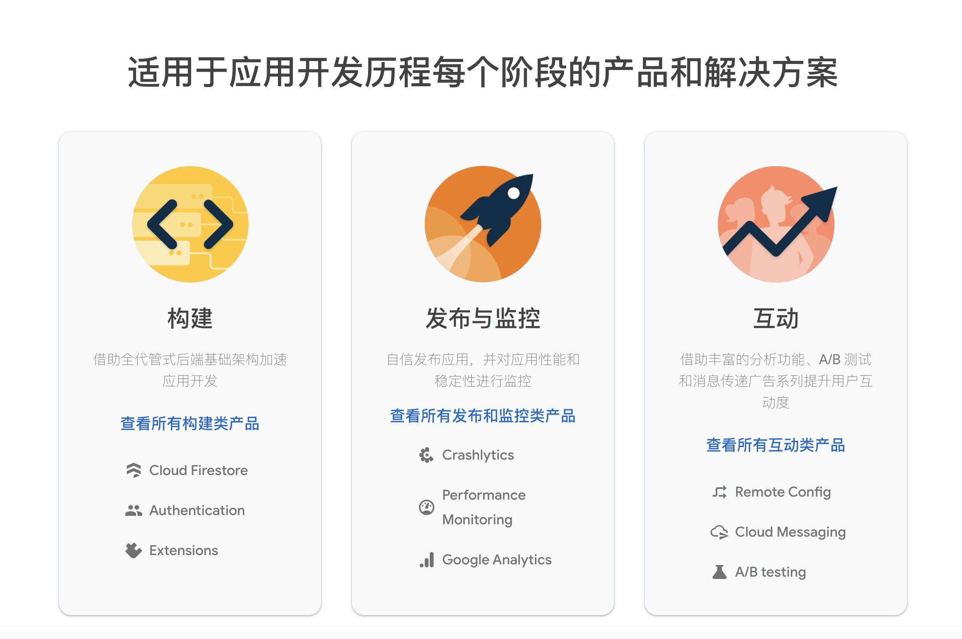

Firebase
Notes:
So, my first bit of advice about authentication…is to use it. Have a policy that ensures the security of app data–and of user data–by verifying your users’ identities, and implement the right technology that matches your policy.
So, what are your options?

Slide 3
Firebase常用功能总结（一）
https://firebase.google.com/docs/auth/android/firebaseui?hl=zh-cn
1.app埋点：Analytics
应用内数据上报，帮助分析用户在app内的行为
2.云消息推送：Firebase Cloud Message
即：FCM，帮助app推送通知
3.身份验证：Authentication
方便的实现google登录，facebook登录，twitter登录，github登录，邮箱登录，电话登录以及自定义验证登录
4.实时数据库：Database和最新的Firestore
无需搭建服务器就能拥有一个实时的数据库，可以用来保存自己想要保存的任何数据。
5.云仓库：Cloud Storage
无需搭建服务器就能拥有一个云仓库，可以用来保存文件，如图片、音频、视频。不过免费版最多保存1个G的文件。
Notes:
So, my first bit of advice about authentication…is to use it. Have a policy that ensures the security of app data–and of user data–by verifying your users’ identities, and implement the right technology that matches your policy.
So, what are your options?

Slide 4
Firebase常用功能总结（二）
https://firebase.google.com/docs/auth/android/firebaseui?hl=zh-cn
6.app崩溃报告：Firebase Crashlytics 类似国内bugly
7.Firebase远程配置：Remote Config
8.A/B测试
9.动态链接：Dynamic Link 类似 APPFly 的 DeepLink
10.机器学习：Firebase Machine Learning ：https://firebase.google.com/docs/ml?hl=zh-cn
主要功能实现：文字识别 图片标注 物体检测和跟踪 脸检测和轮廓追踪 条码扫描 语言识别 翻译 智能回复
Notes:
So, my first bit of advice about authentication…is to use it. Have a policy that ensures the security of app data–and of user data–by verifying your users’ identities, and implement the right technology that matches your policy.
So, what are your options?

Slide 5
Firebase 接入项目中
https://firebase.google.com/docs/android/setup?hl=zh-cn
1.将 Firebase SDK 添加到项目中：com.google.firebase:firebase-bom
2.在Firebase 控制台添加项目,并添加相关配置（包名，签名等）
3.将Firebase 控制台的google-services.jason配置到android 中,GoogleService-Info.plis配置到ios中，生成新的服务端用的json 配置到服务端结合 Firebase Admin sdk 使用
Notes:
So, my first bit of advice about authentication…is to use it. Have a policy that ensures the security of app data–and of user data–by verifying your users’ identities, and implement the right technology that matches your policy.
So, what are your options?

Slide 6
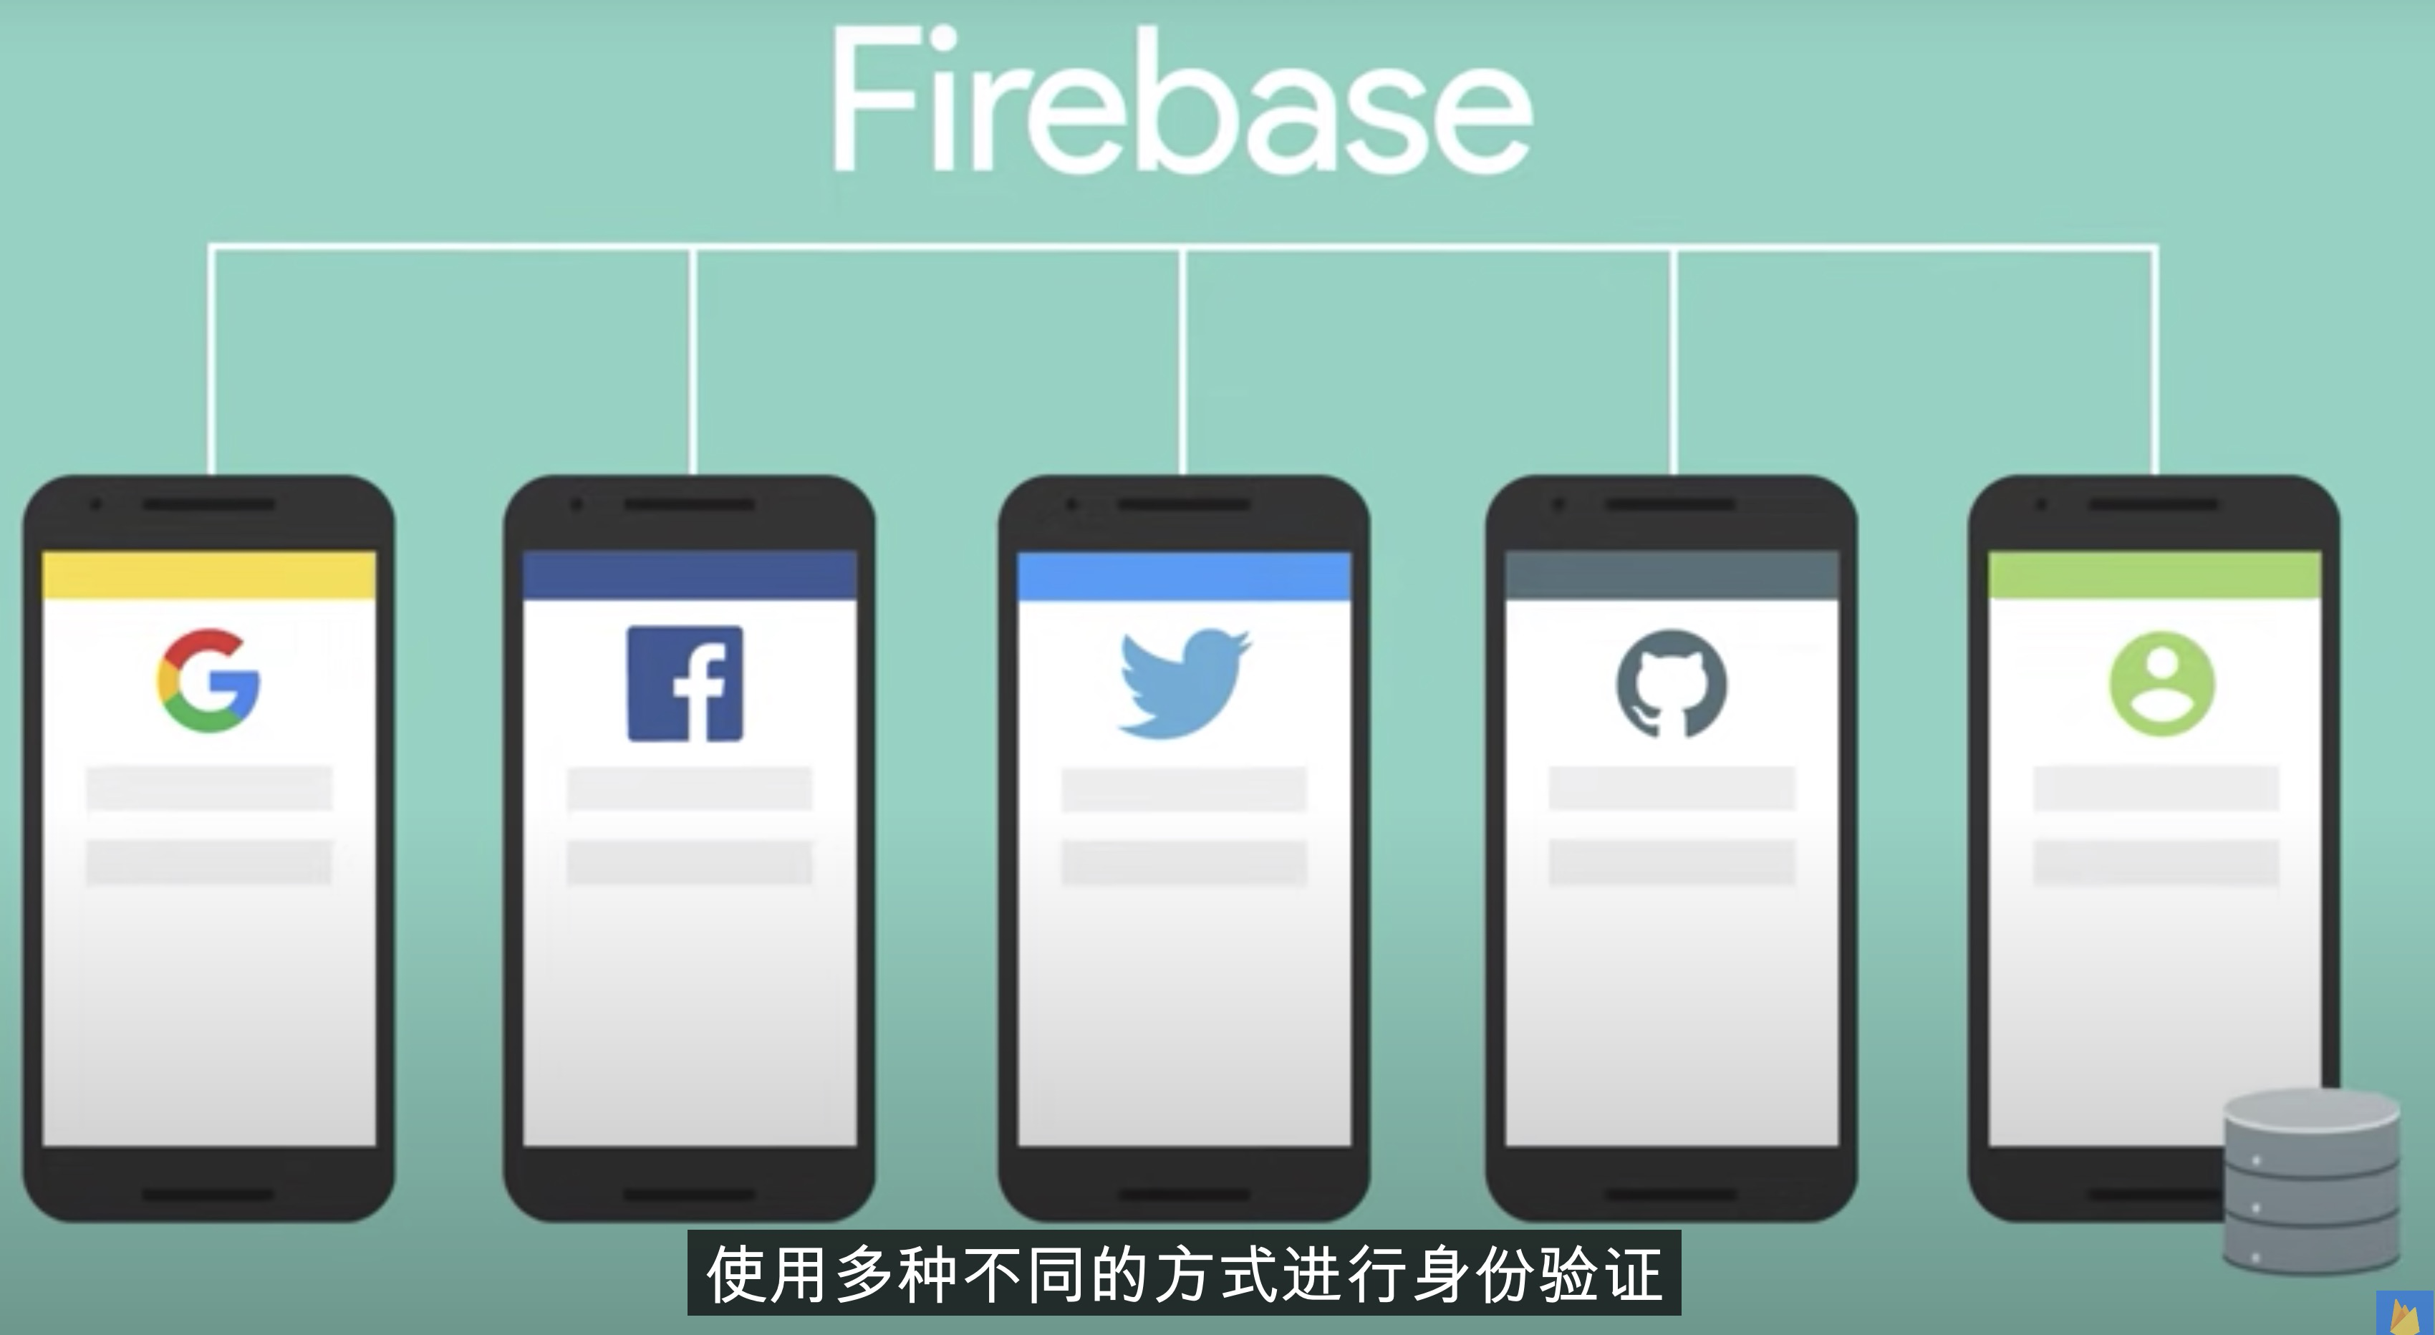
Firebase 身份验证：Authentication
Notes:
So, my first bit of advice about authentication…is to use it. Have a policy that ensures the security of app data–and of user data–by verifying your users’ identities, and implement the right technology that matches your policy.
So, what are your options?

Slide 7

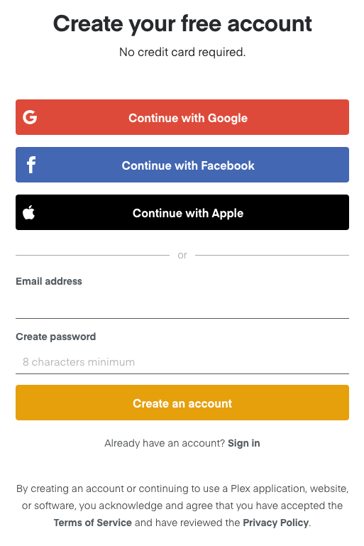
Notes:
Which should you use? Well, it makes sense to use the identity provider that matches its respective platform. So… Google Sign-In for Android and Sign in with Apple for iOS, for example. Keep in mind, though, that if you support one of these mechanisms for your app on one platform, you should also support that same mechanism on all the other platforms your app runs on, too. Otherwise, a user who has an Android phone and an iPad might not be able to sign in to your app on all of their devices!

Slide 8
import { getAuth, getRedirectResult, GoogleAuthProvider } from "firebase/auth";
const auth = getAuth();
getRedirectResult(auth)
.then((result) => {
const credential = GoogleAuthProvider.credentialFromResult(result);
const token = credential.accessToken;
const user = result.user;
// ...
}).catch((error) => {
// ...
});
Notes:
Here’s an example of using Google Sign-In with a web app. This uses the option to sign in with a redirect to Google’s login page. Using a redirect is the preferred method on mobile devices.
However, one thing to note here is that a redirect doesn’t work on browsers that block third-party cookies. Luckily, there are solutions to this that provide a link.

Slide 9
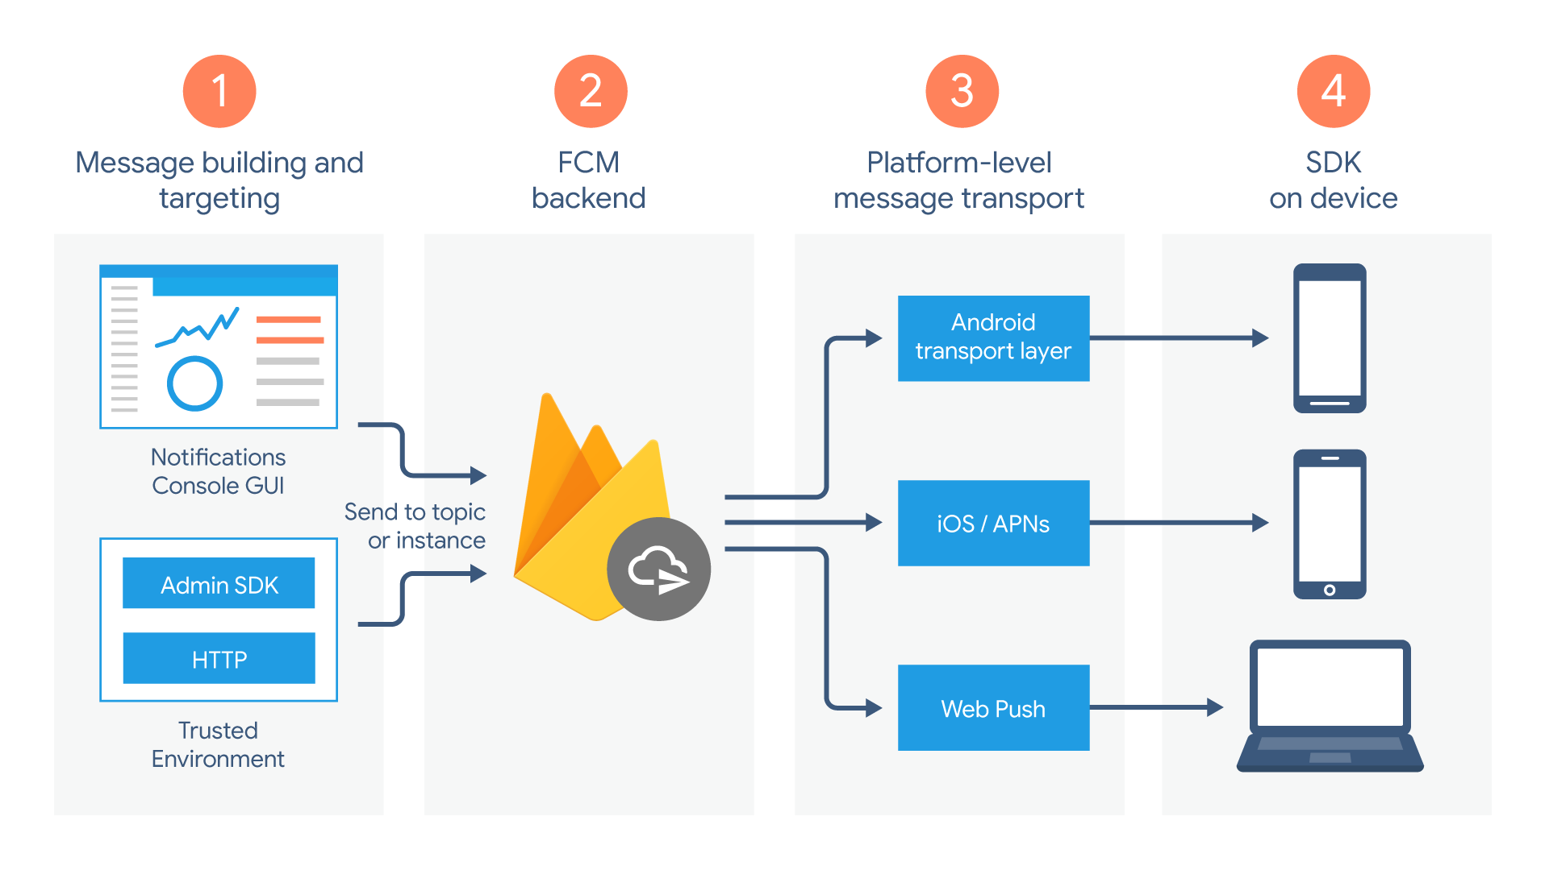
Firebase 推送:FCM
https://firebase.google.com/docs/cloud-messaging/?hl=zh-cn
https://youtu.be/8sGY55yxicA?list=PLl-K7zZEsYLmOF_07IayrTntevxtbUxDL
Firebase Cloud Messaging (FCM) 是一种跨平台消息传递解决方案，可供您可靠地传递消息，且无需任何费用。
Notes:
So, my first bit of advice about authentication…is to use it. Have a policy that ensures the security of app data–and of user data–by verifying your users’ identities, and implement the right technology that matches your policy.
So, what are your options?

Slide 10
Firebase 推送:FCM
FirebaseMessaging.getInstance().getToken().addOnCompleteListener(new OnCompleteListener<String>() {
@Override
public void onComplete(@NonNull Task<String> task) {
if (!task.isSuccessful()) {return;}
String token = task.getResult();
// TODO: upload fcm token to backend
}
});
}
public class AppFirebaseMessagingService extends FirebaseMessagingService {
@Override
public void onMessageReceived(@NonNull RemoteMessage message) {
super.onMessageReceived(message);
Map<String, String> dataMap = message.getData();
if (dataMap == null || dataMap.isEmpty()) {return;}
String json = GsonConverter.toJson(dataMap);
if (TextUtils.isEmpty(json)) {return;}
FirebaseMessage firebaseMessage = GsonConverter.fromJson(json, FirebaseMessage.class);
// TODO: 按照不太用的消息类型去做不同逻辑
}
@Override
public void onNewToken(@NonNull String token) {
super.onNewToken(token);
// TODO: update backend fcm token
}
}
Notes:
Here’s an example of using Google Sign-In with a web app. This uses the option to sign in with a redirect to Google’s login page. Using a redirect is the preferred method on mobile devices.
However, one thing to note here is that a redirect doesn’t work on browsers that block third-party cookies. Luckily, there are solutions to this that provide a link.

Slide 11
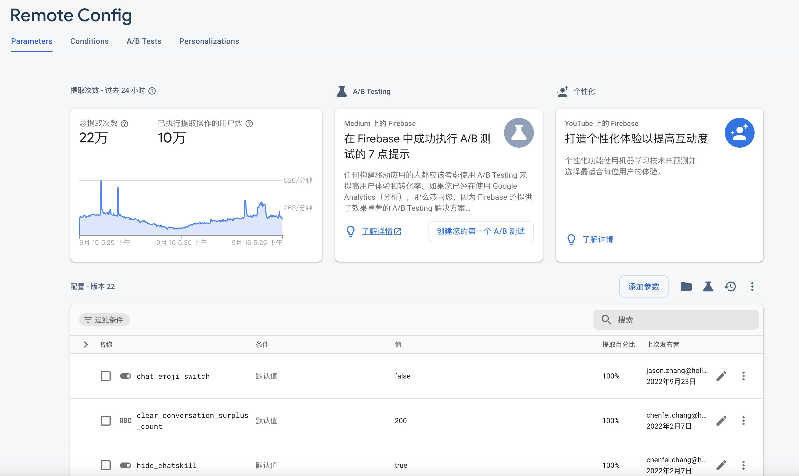
Firebase Remote Config
https://firebase.google.com/docs/remote-config?hl=zh-cn
使用 Firebase Remote Config 来定义应用中的参数并在云端更新它们的值。这样，您无需更新应用即可修改应用的外观和行为
Notes:
So, my first bit of advice about authentication…is to use it. Have a policy that ensures the security of app data–and of user data–by verifying your users’ identities, and implement the right technology that matches your policy.
So, what are your options?

Slide 12
Firebase Remote Config
FirebaseRemoteConfig firebaseRemoteConfig = FirebaseRemoteConfig.getInstance();
FirebaseRemoteConfigSettings configSettings = new FirebaseRemoteConfigSettings.Builder()
.setMinimumFetchIntervalInSeconds(3600)
.build();
firebaseRemoteConfig.setConfigSettingsAsync(configSettings);
firebaseRemoteConfig.setDefaultsAsync(R.xml.remote_config_defaults);
boolean isShowNewUi = firebaseRemoteConfig.getBoolean("is_show_new_ui");
if (isShowNewUi) {
// TODO: show new ui
} else {
// TODO: show old ui
}
Notes:
Here’s an example of using Google Sign-In with a web app. This uses the option to sign in with a redirect to Google’s login page. Using a redirect is the preferred method on mobile devices.
However, one thing to note here is that a redirect doesn’t work on browsers that block third-party cookies. Luckily, there are solutions to this that provide a link.

Slide 13
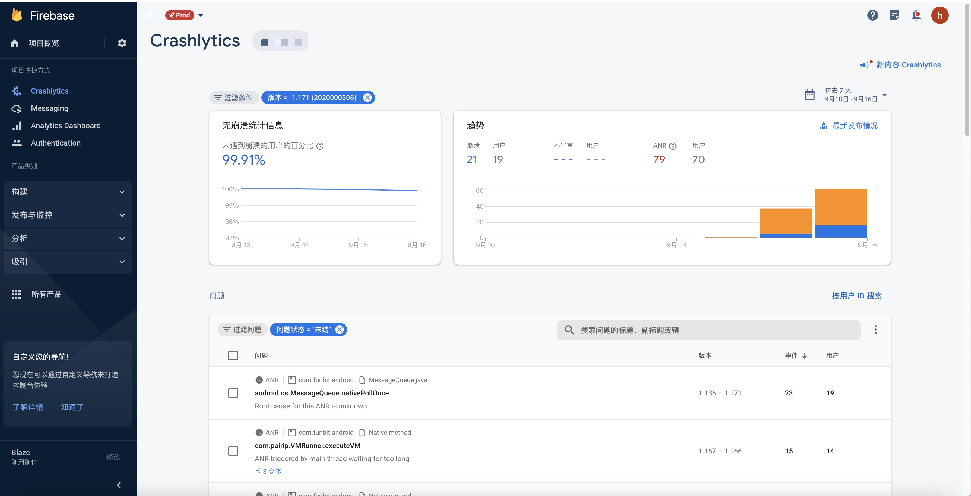
Firebase Crashlytics
https://firebase.google.com/docs/crashlytics?hl=zh-cn
Firebase Crashlytics 是一个轻量级的实时崩溃报告解决方案，可帮助对影响应用质量的稳定性问题进行跟踪、确定优先解决顺序并加以修复。 Crashlytics 会对崩溃进行智能分组并突出显示导致这些崩溃的环境因素，从而节省问题排查的时间。当某个问题突然变得严重时收到提醒。一般以邮件形式提醒
Notes:
So, my first bit of advice about authentication…is to use it. Have a policy that ensures the security of app data–and of user data–by verifying your users’ identities, and implement the right technology that matches your policy.
So, what are your options?

Slide 14
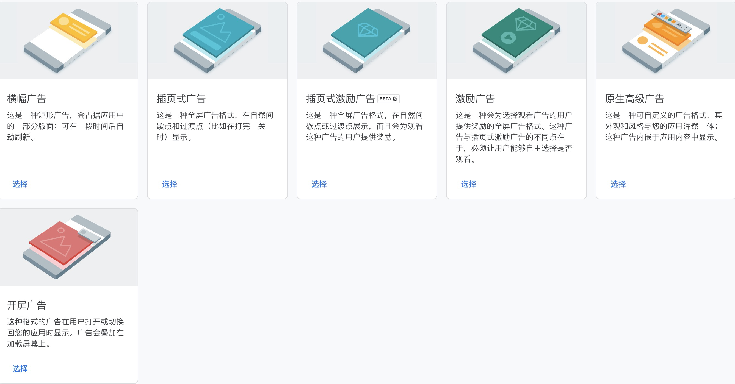
Firebase + AdMob
Google AdMob 是通过在应用内投放有针对性的广告，利用移动应用创收的一种简单方式。
Notes:
So, my first bit of advice about authentication…is to use it. Have a policy that ensures the security of app data–and of user data–by verifying your users’ identities, and implement the right technology that matches your policy.
So, what are your options?

Slide 15
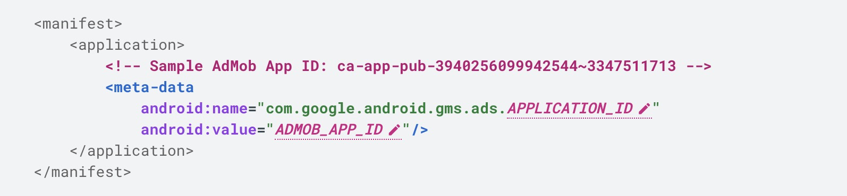
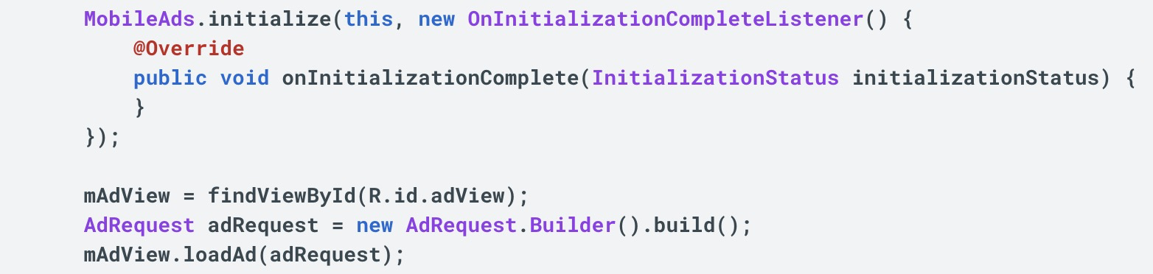
Firebase + AdMob
第 1 步：在 AdMob 账号中设置应用
第 2 步：将 AdMob 应用 ID 添加到 AndroidManifest.xml 文件中
第 3 步：添加并初始化移动广告 SDK
implementation("com.google.android.gms:play-services-ads:xx.xx")
Application中初始化：MobileAds.initialize(this)
第 4 步：选择要植入不同样式的广告（注意:测试的时候一定要用测试专用广告单元 ID）
Notes:
So, my first bit of advice about authentication…is to use it. Have a policy that ensures the security of app data–and of user data–by verifying your users’ identities, and implement the right technology that matches your policy.
So, what are your options?

Slide 16
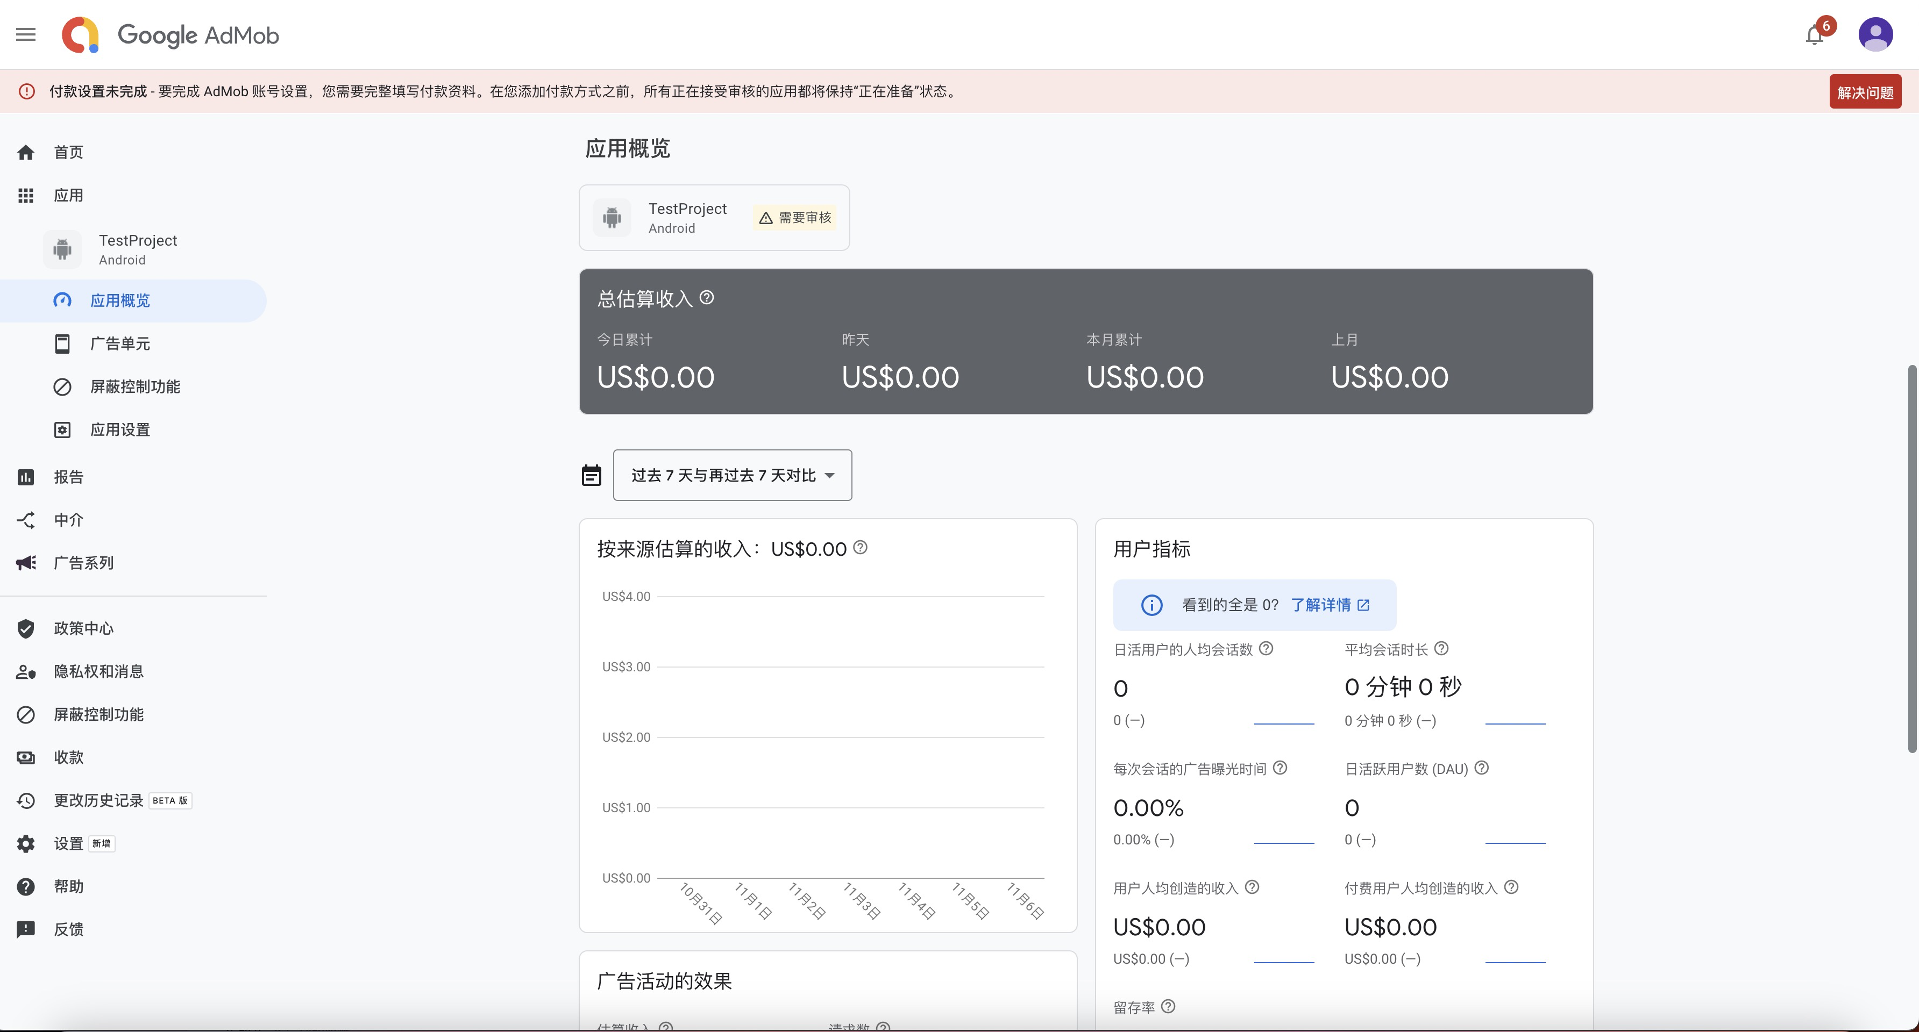
Firebase + AdMob
Notes:
So, my first bit of advice about authentication…is to use it. Have a policy that ensures the security of app data–and of user data–by verifying your users’ identities, and implement the right technology that matches your policy.
So, what are your options?

Slide 17

Thank You!
Notes:
And I hope you get lots of users to authenticate! Millions of them! Make sure that each of them has a seamless–and secure–login experience for your Firebase app.
Thanks for listening - stay safe and secure!

